Slide 1
Data Analytics
Project Report
HR Analytics for Mutual Funds
Employee Performance Compensation Attrition Succession Planning
| IBM HR Analytics Dataset |
| Microsoft Excel (Pivot Tables, Charts, Dashboard) | | Roshitha |
| March–April 2026|

Slide 2
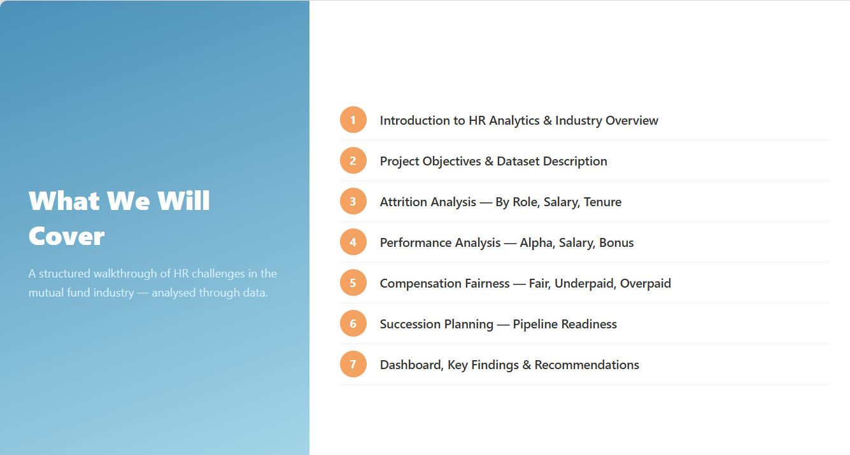

Slide 3
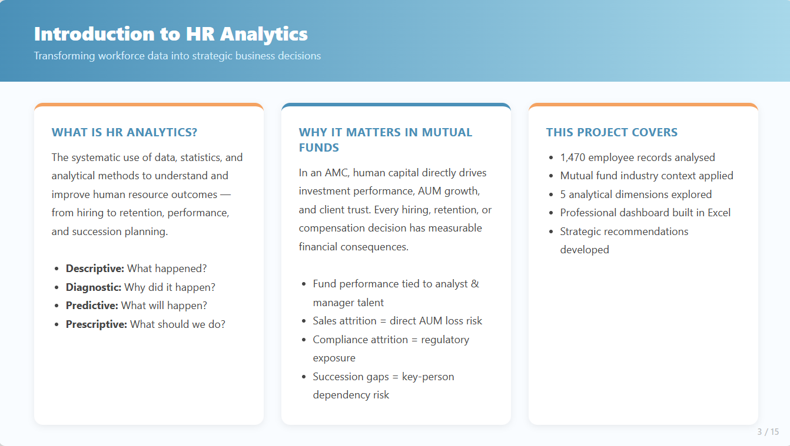

Slide 4
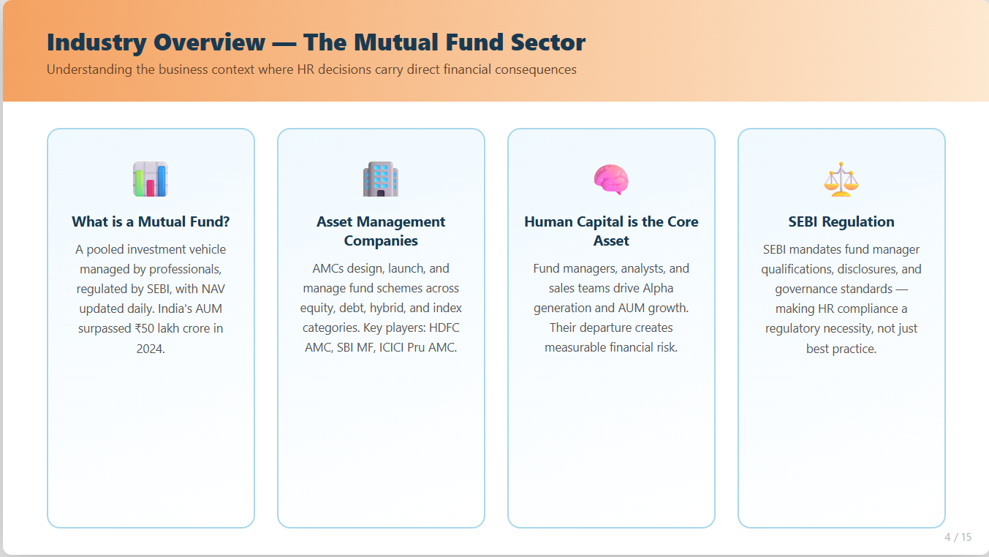

Slide 5
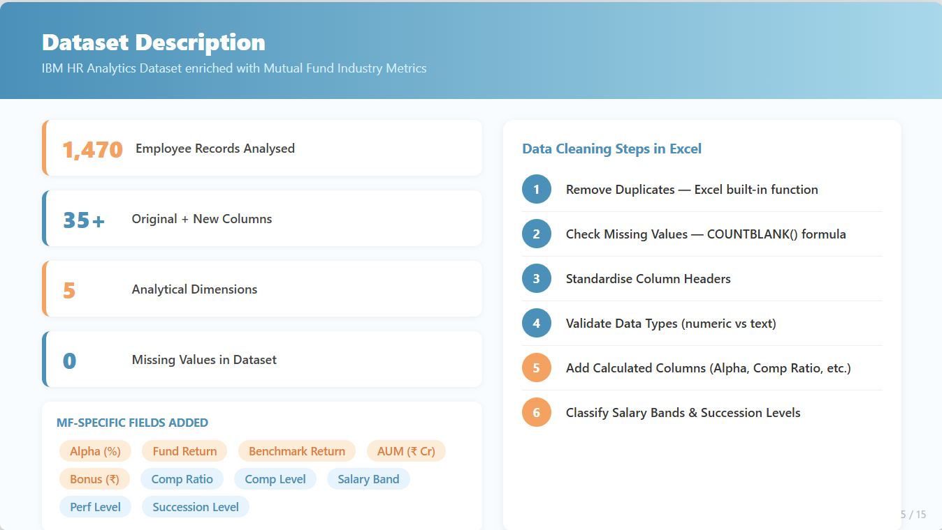

Slide 6
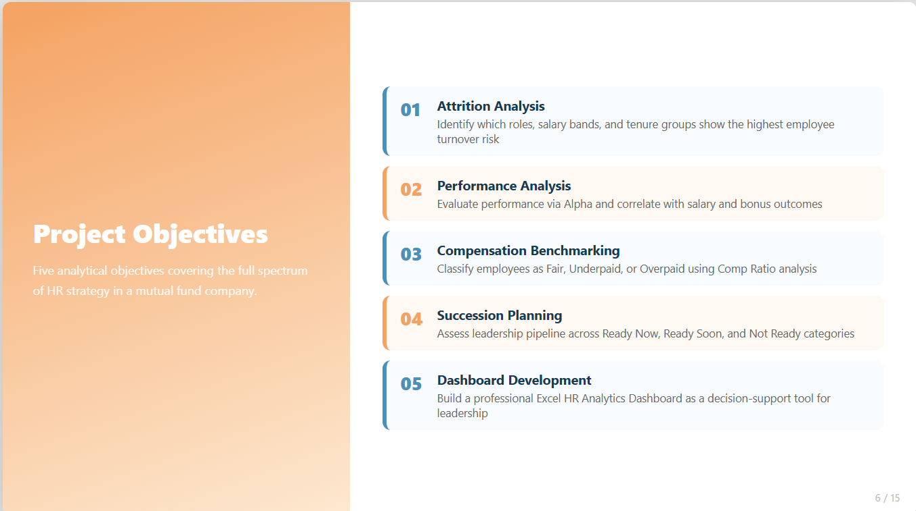

Slide 7
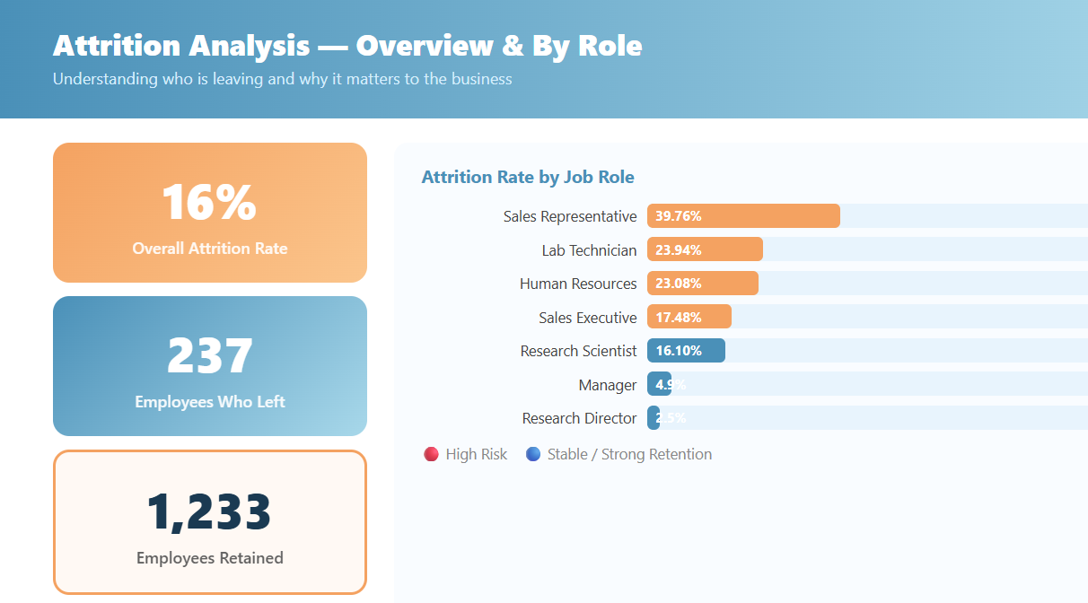

Slide 8
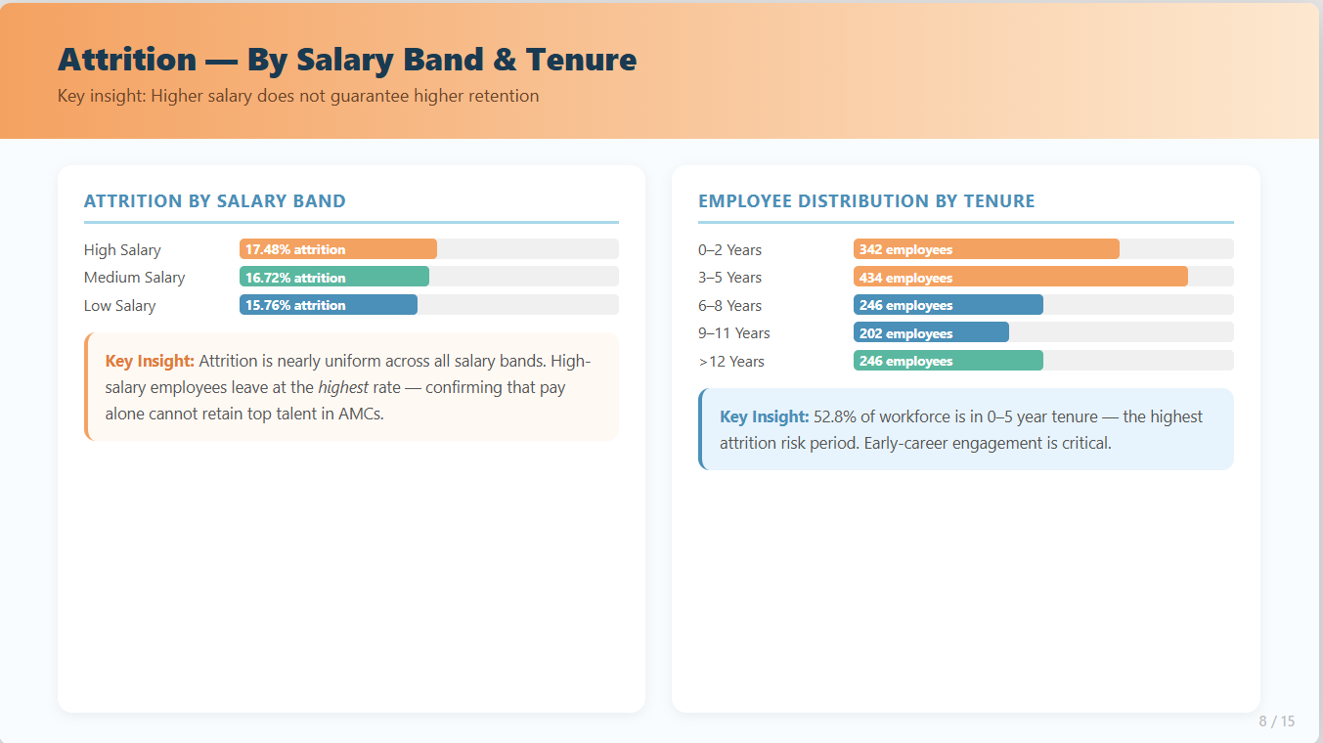

Slide 9
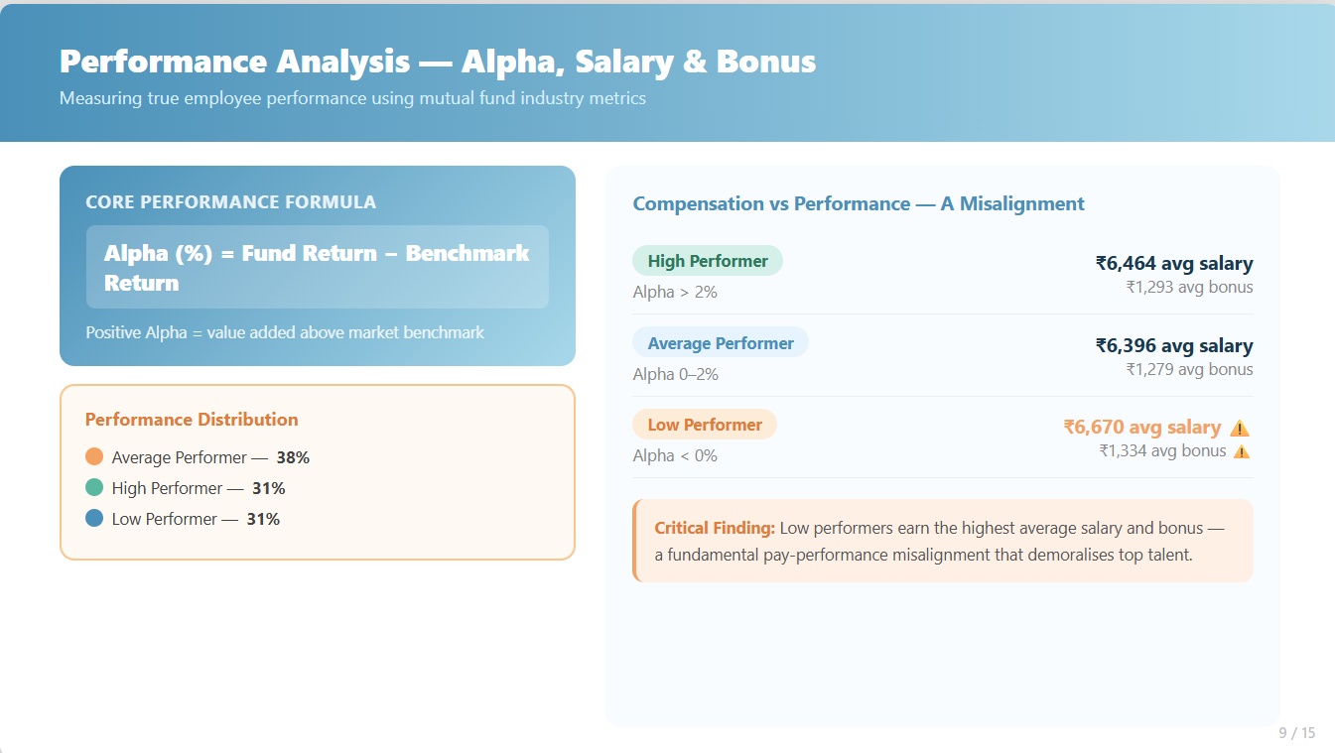

Slide 10
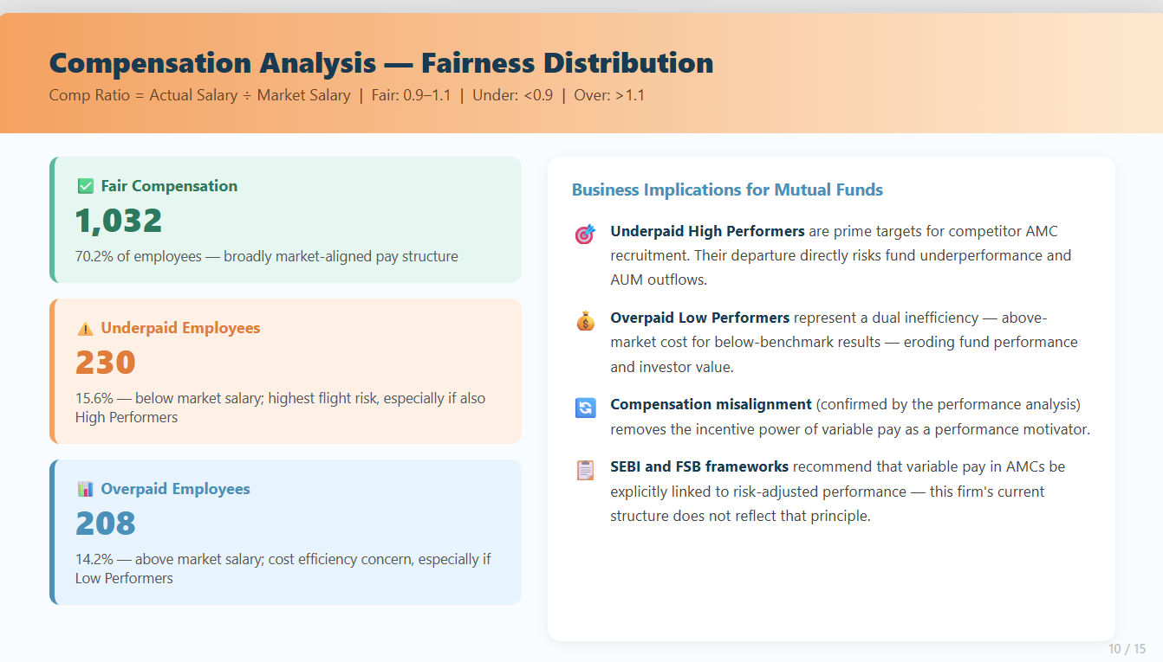

Slide 11
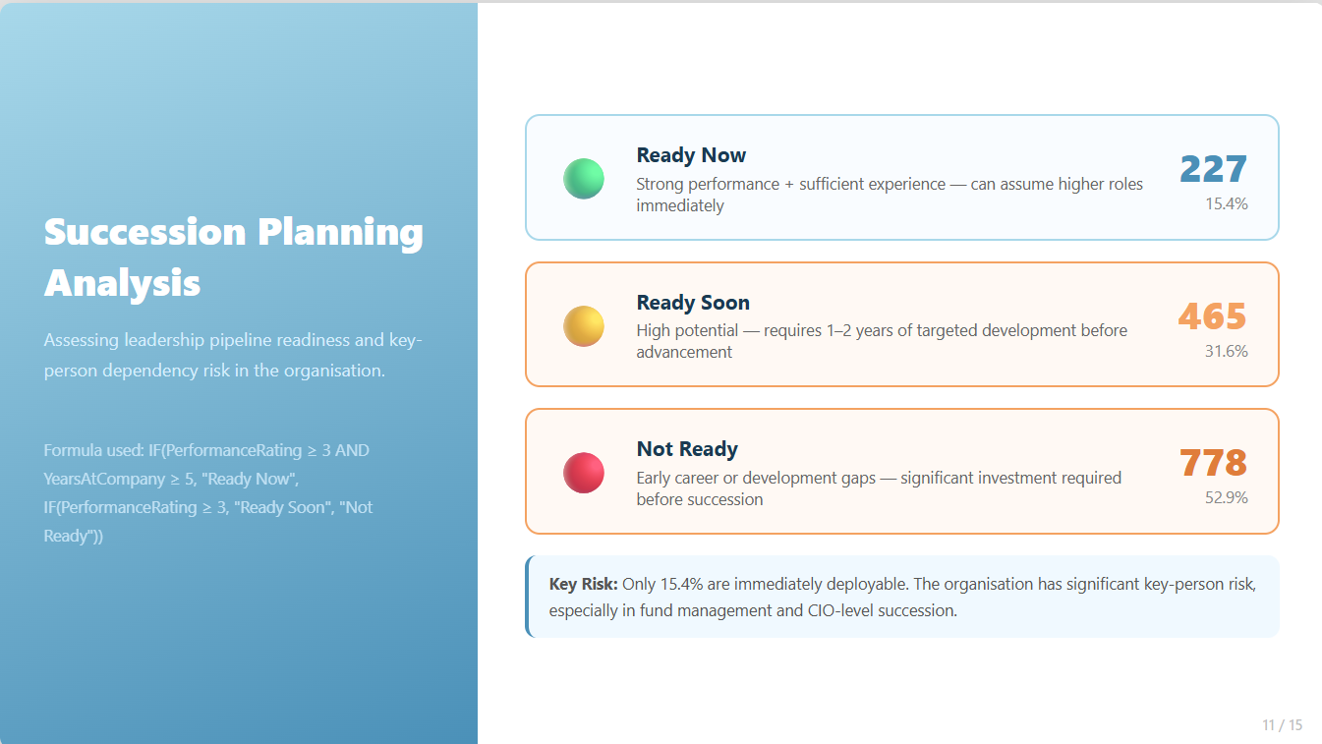

Slide 12
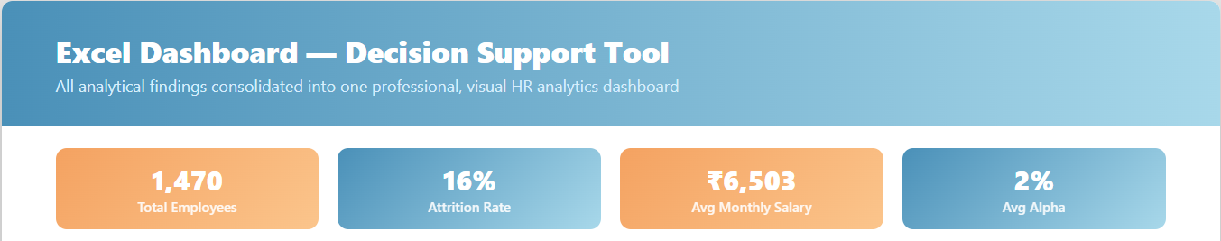
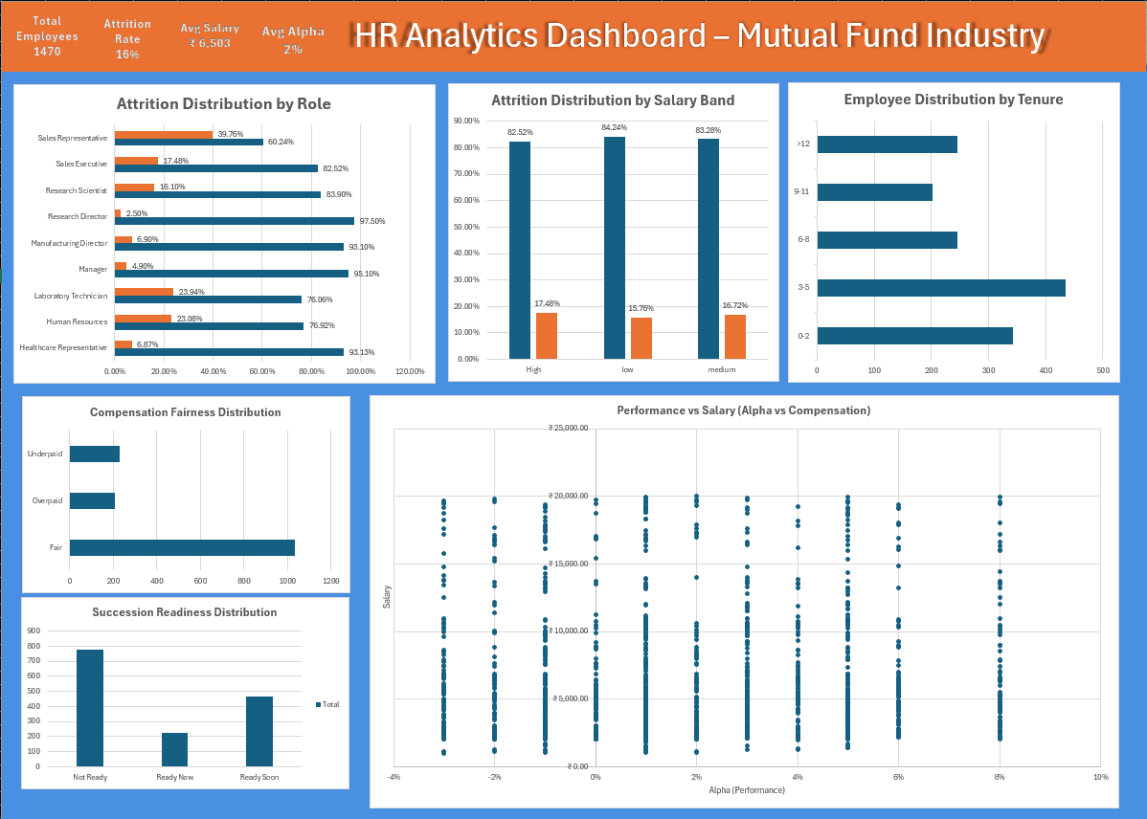

Slide 13
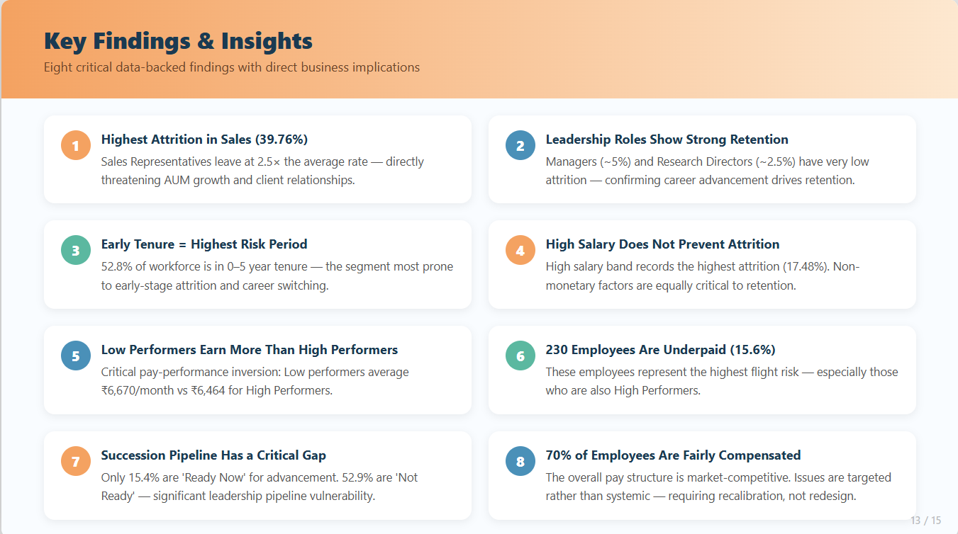

Slide 14
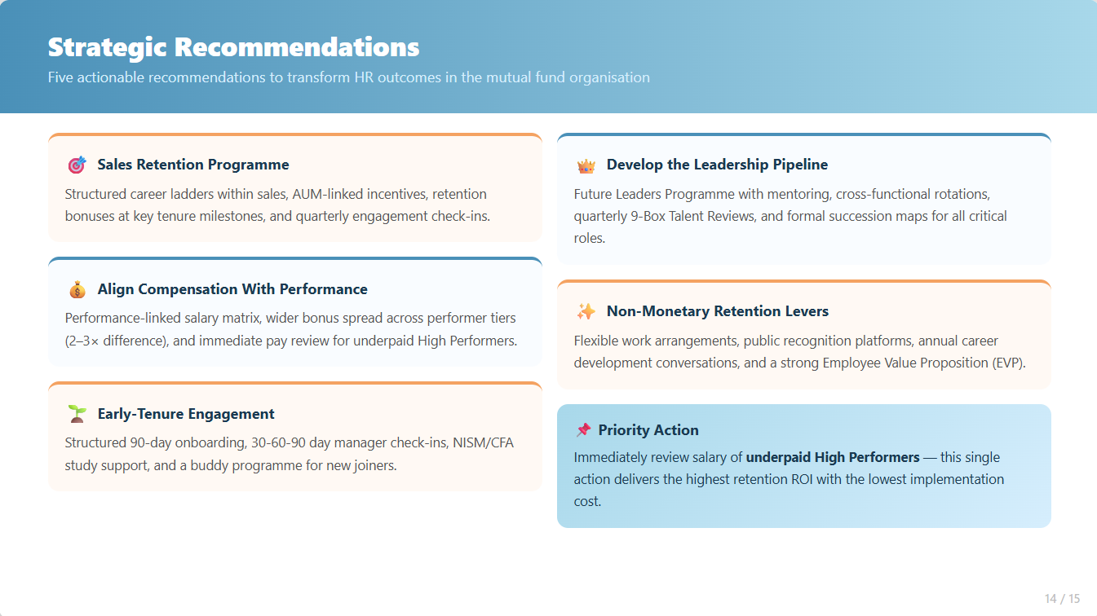

Slide 15
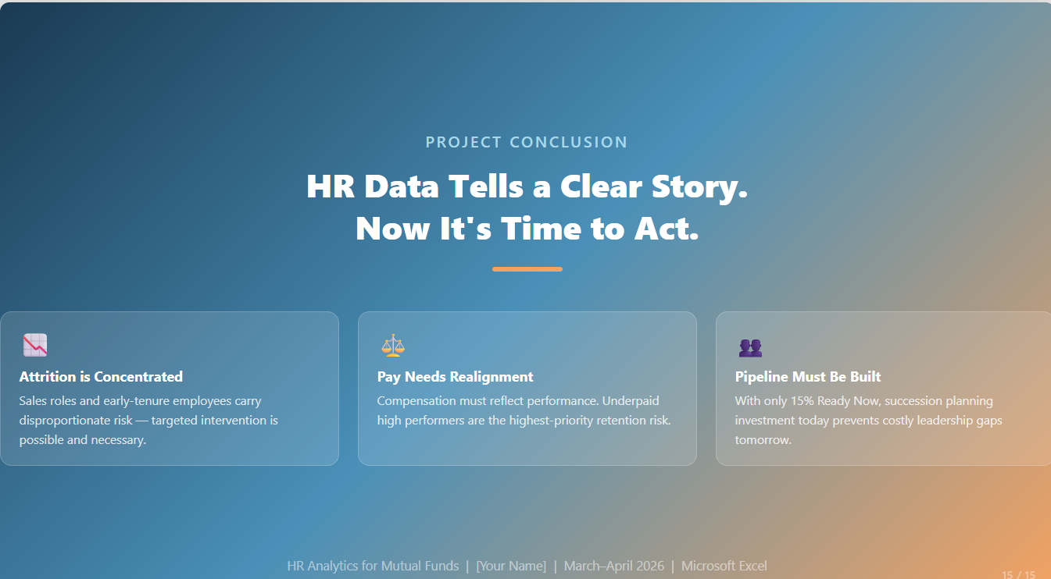
HR Analytics for Mutual Funds | Roshitha | March–April 2026 | Microsoft Excel

